Slide 1

MAD-3115 Final Project (F2018) iOS Programming Fundamentals
TEAM NAME: SPARTANS
PROJECT TITLE: CREATE AN IOS APPLICATION FOR THE PARKING TRACKING SYSTEM
TEAM MEMBERS: AJAY SACHDEVA (C0738024)
DAIAN AIZIATOV (C0743383)
TASNEEM BOHRA (C0744634)

Slide 2
MAD-3115 Final Project Planning
SPRINT 1 (Oct 26-Nov 2) | SPRINT 2 (Nov 2 - 9) | SPRINT 3 (Nov 10 -16) | SPRINT 4 (Nov 17-19)
PROJECT SETUP | HOME SCREEN | INSTRUCTION SCREEN | TESTING
SPLASH SCREEN DESIGN | MENU SCREEN | DATE FORMAT | BUG FIXING
APP LOGO DESIGN | LOGIN SCREEN | FRAMEWORK DESIGN
LOGIN SCREEN DESIGN | RECEIPT VIEW | ADVANCED MAP
SIGNUP SCREEN DESIGN | REPORT SCREEN | PARKING TICKET PHOTO PROOF
DATABASE DESIGN | ADD NEW TICKET SCREEN
DATA STRUCTURE | LOCATION

Slide 3
Risks And Dependencies
Risks:
Loss of User Data from Database
Wrong User Location Determination
Problem with authorization of users
Dependencies:
Key Chain Access
IQ Keyboard Manager Swift
Sky Floating Label Text Field
Animated Switch
Firebase

Slide 4
Outcome
What we learnt?
During this project, we learnt
New Technologies
How to make proper logics
How to set constraints
How to use a database in iOS

Slide 5
Outcome
What difficulties we faced?
During the project, following difficulties were faced:
Setting Constraints
Less Official Documentation to follow
Making Logics
Using a database with iOS

Slide 6
Technologies Used
iOS/Swift
POD
Key Chain
Firebase

Slide 7
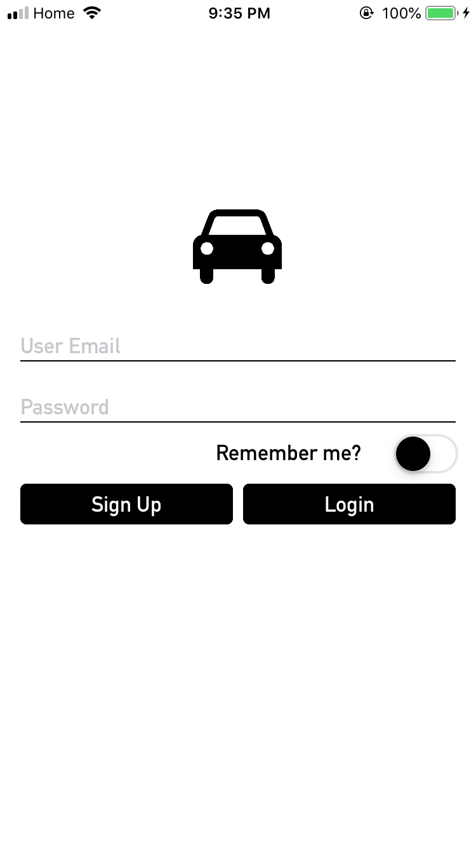
Login Screen
This screen is used to login into user account.
The user can only login if there exists a user account with same credentials in the database.
There is a Remember Me switch to remember the information of last logged in user.

Slide 8
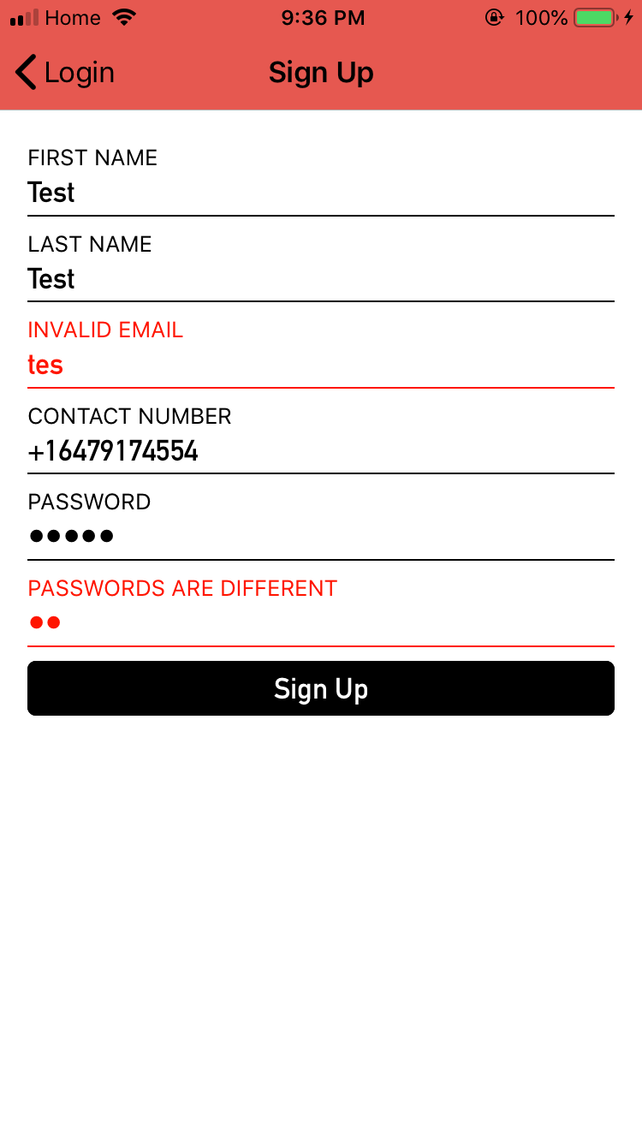
Sign UP Screen
This screen is used to create a new user account. The user can sign up by filling all the information. There are e-mail and password validations for this screen.

Slide 9
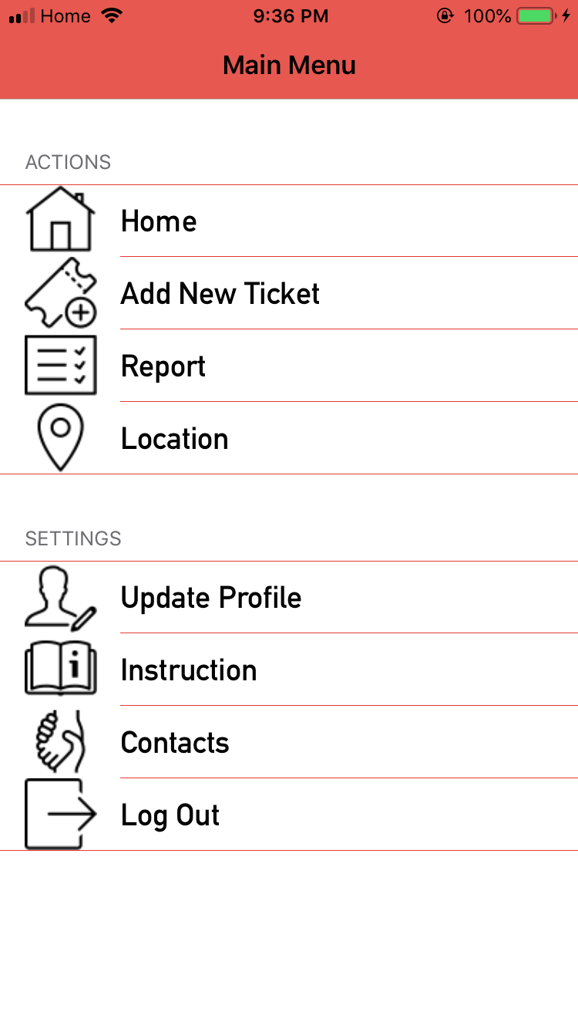
Main Menu
This screen contains the main menu after logging in.
In Home, users can see their login information and can add new cars.
In Add New Ticket, user can add ticket to a previously added car or can add a new car to their car list. After adding a car, user needs to enter information for the parking, prices will change accordingly.
In Report, user can see the parking information till date.
In location, user can see the parked location of their car on the Map.
In Update Profile, user can only update Password.
In Instructions, the user can view basic law enforcements followed.
In contacts, the user can contact via SMS, e-mail or call.
Log Out can be used to log out of the app.

Slide 10
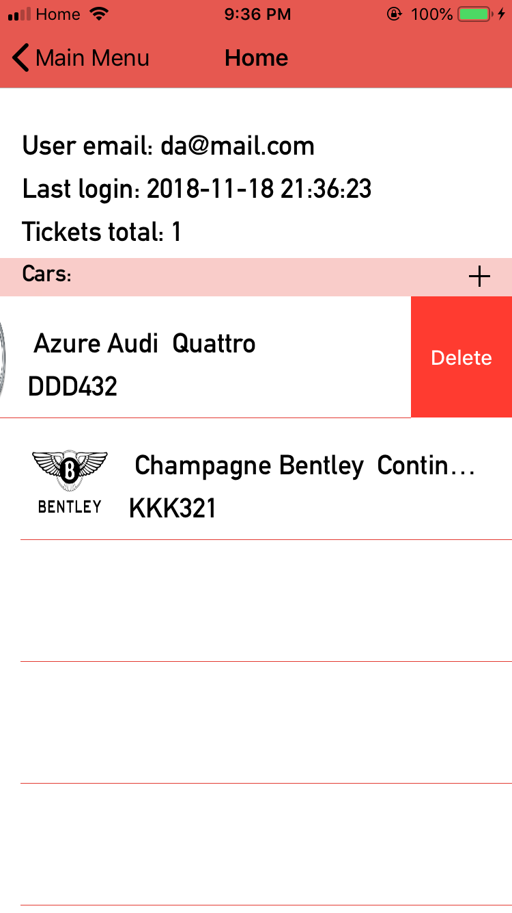
Home Screen
In Home Screen, the user can add/delete cars.
The user can add cars by simply tapping the (+) icon and can delete cars by swiping the car name to the left and then tapping delete.

Slide 11
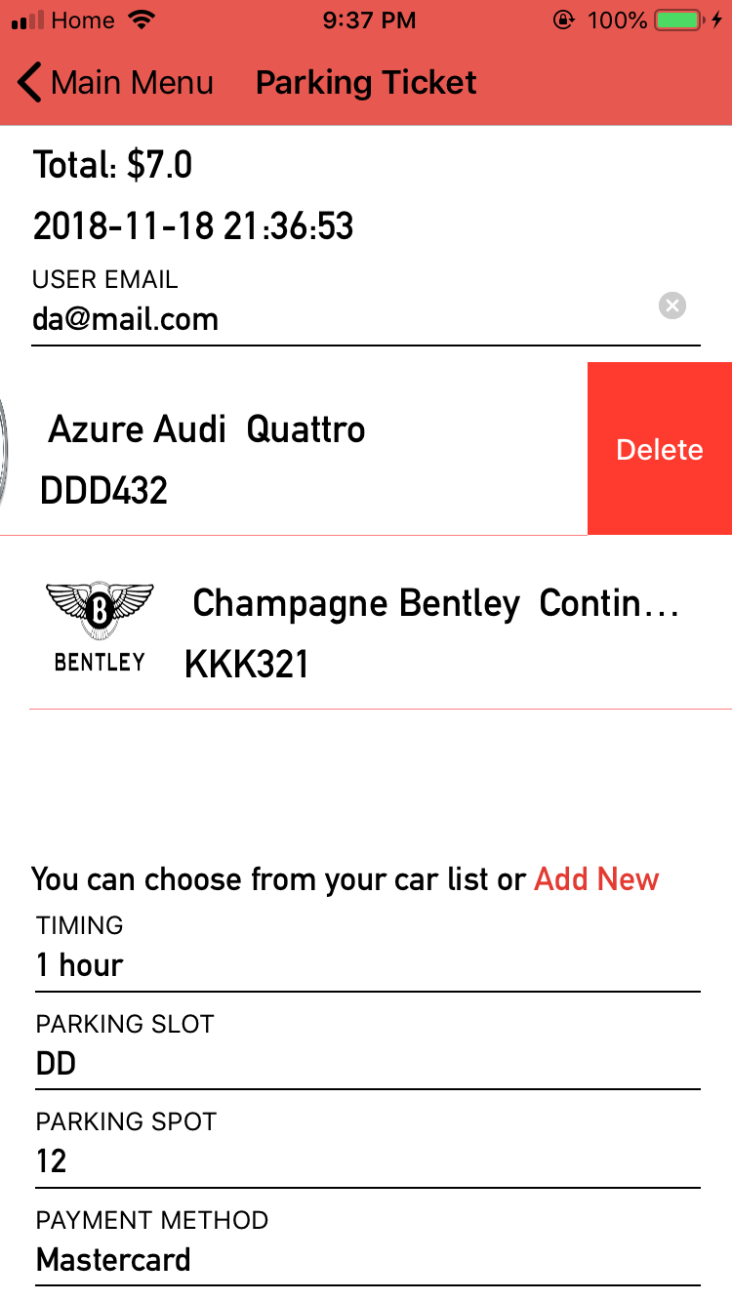
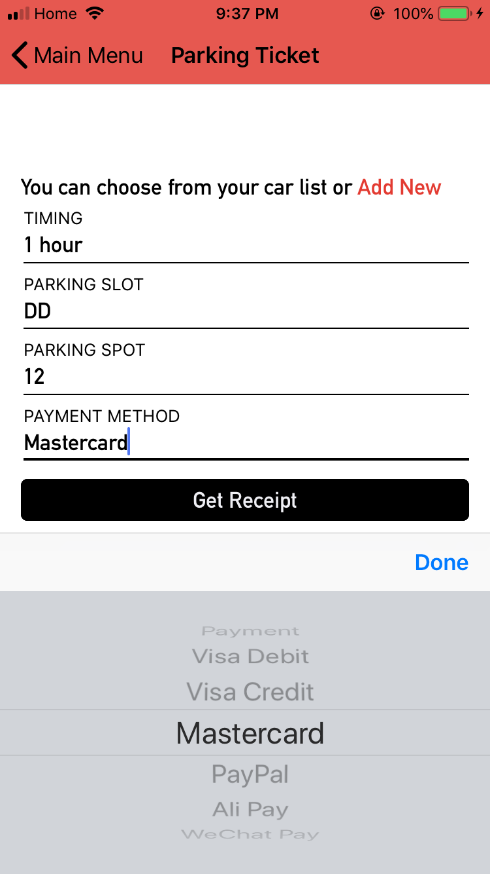
Add New Ticket
After selecting the car, the user can add a parking ticket by entering
details- Parking Timing, Parking Slot,
Parking Spot and Payment Methods.
After filling all the information, user can click on get receipt to get a parking receipt.
The user can save that receipt as a PDF file as well.

Slide 12
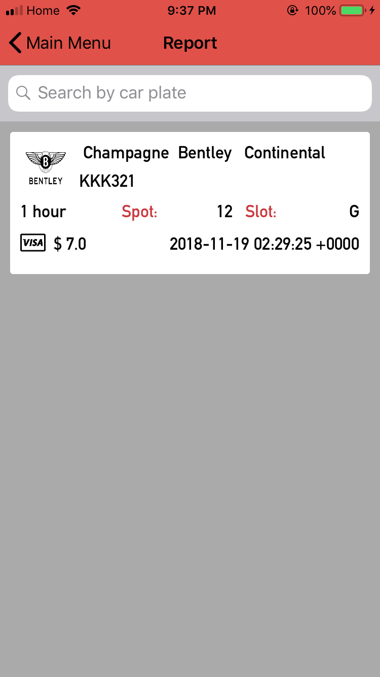
Report
This screen contains the full report of a user’s parking's till date.
If a user has multiple cars, this screen will show all the created tickets of all cars and their parking details.
The user can find a parking ticket by entering the car plate in search bar.

Slide 13
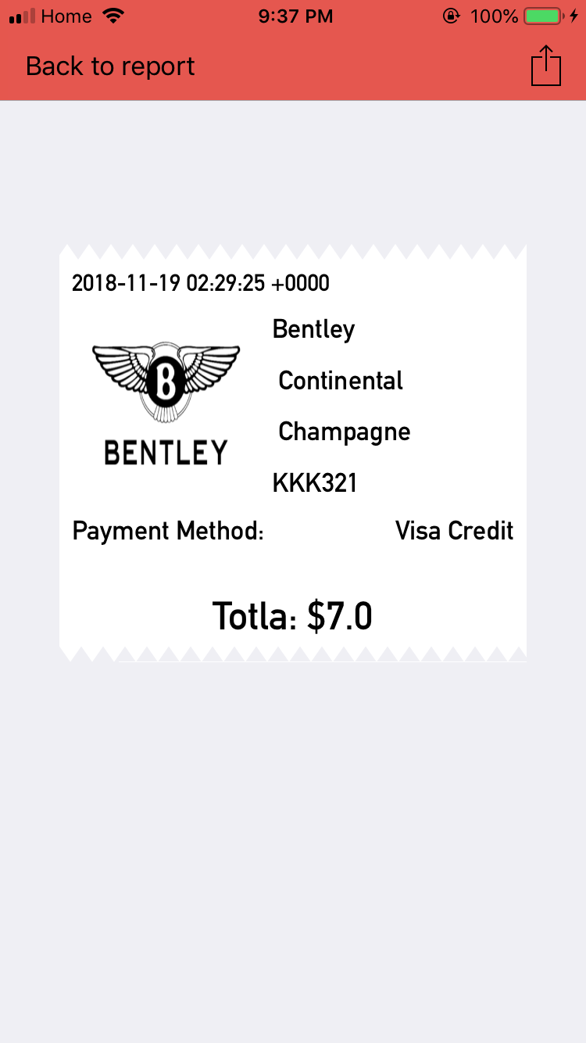
Receipt
When the user selects a ticket from all reports, that ticket will show up like this.
By tapping the shared/action button the user can save the receipt in PDF format or can share it as well.

Slide 14
PDF Sample
If a user chooses to share the receipt as a PDF, the PDF will be displayed like above.

Slide 15
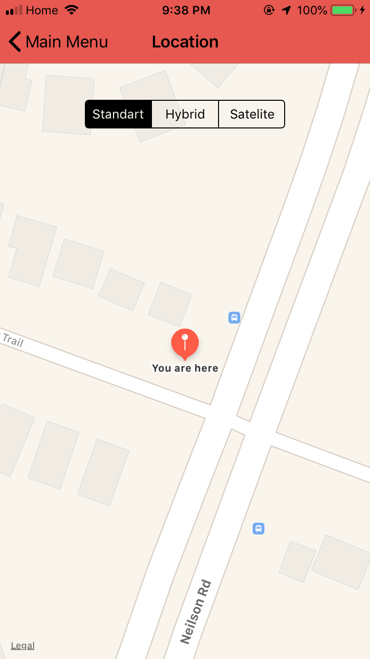
Location
This screen shows the user’s current location on the Map.

Slide 16
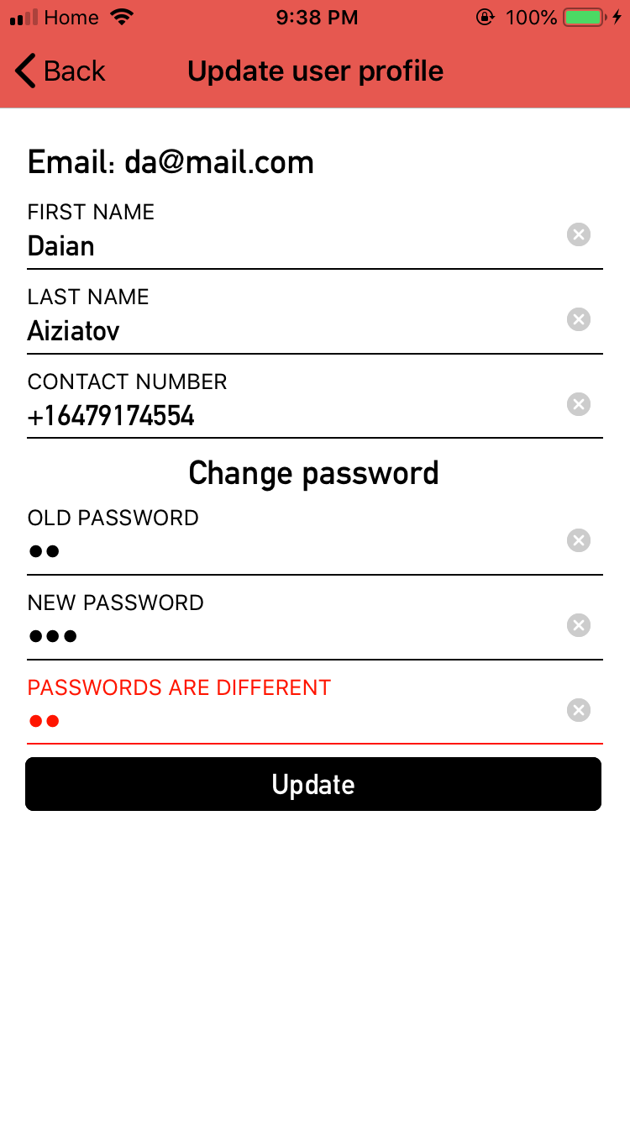
Update Profile
This screen is used to update a user’s profile.
The user can change their First Name, Last Name, Contact Number and Password(Optional).
The user can’t change their e-mail address.

Slide 17
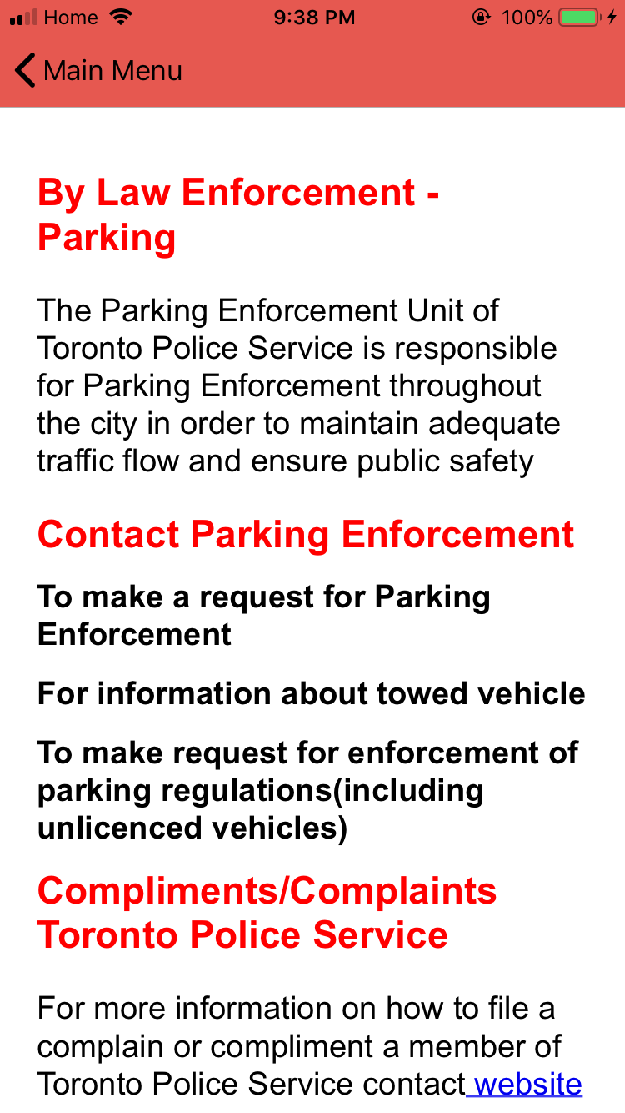
Instructions
This screen contains the information about Parking Law Enforcements and how to file a complaint to Toronto Police Service.

Slide 18
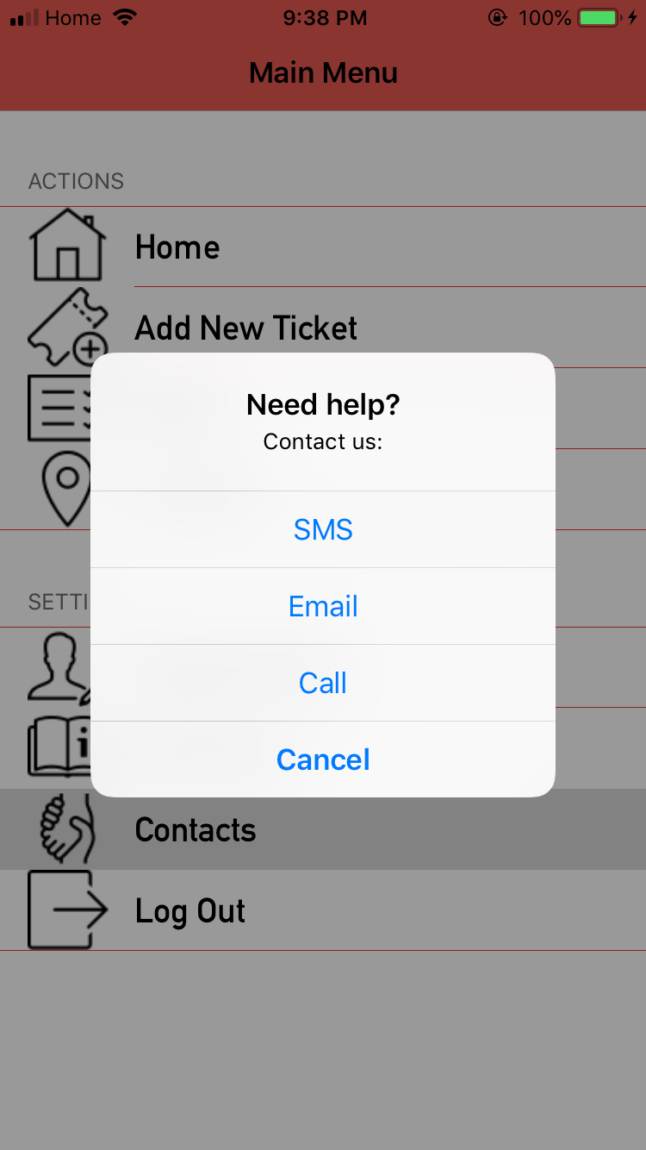
Contact US:
When a user taps on contacts, following screen will appear.
A user can contact using SMS, E-mail or call.

Slide 19
References
https://github.com/kishikawakatsumi/KeychainAccess
https://github.com/hackiftekhar/IQKeyboardManager
https://github.com/Skyscanner/SkyFloatingLabelTextField
https://github.com/alsedi/AnimatedSwitch
https://www.udemy.com/new-firebase
http://userguide.icu-project.org/formatparse/datetime
https://www.ioscreator.com/tutorials/cocoapods-tutorial-ios8-swift
https://firebase.google.com/docs/ios/setup

Slide 20
THANK YOU !

